Slide 1


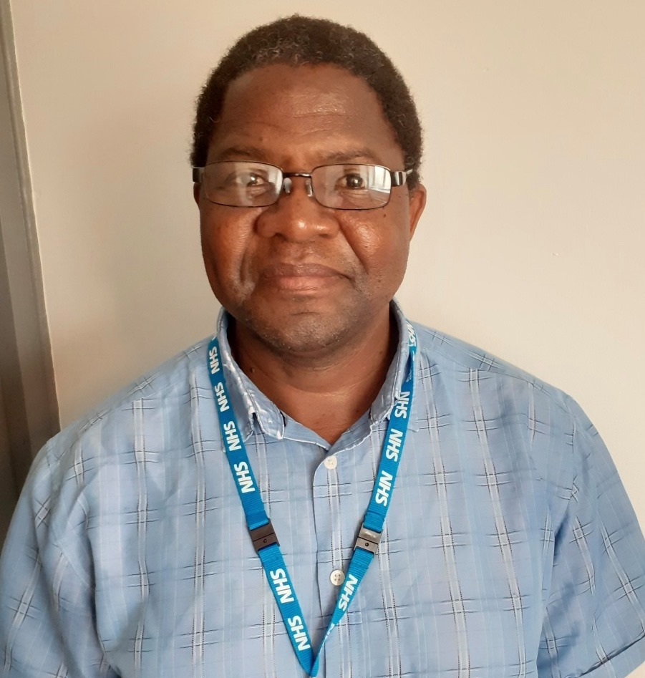



Sex & healthy relationships:
Welcome to new arrivals
This session will be delivered in a non-judgmental, factual manner, allowing participants to ask questions and share their experiences in a safe environment.
Charles Dewa,
Sexual Health Promotion Practitioner
Delivered in partnership with the Red Cross, Derby
This service is funded by Derbyshire County Council and Derby City Council and delivered by Derbyshire Community Health Services NHS Foundation Trust.

Slide 2

My role as a Practitioner for ethnically diverse communities
I help people understand how culture, beliefs, and religion affect sexual health in different communities.
I work with local groups and community leaders to make sure services are easy to access and respect cultural needs.
My job is to help more people from diverse backgrounds use sexual health services.

Slide 3
Group agreement
Listen carefully to others.
Show respect to everyone.
Keep things private. What is shared stays in the group.
Join in and share your ideas.
Take care of yourself and others. Some topics may feel sensitive.
Ask questions, you can write them on paper and give them to me at the end.

Slide 4
What will you learn today?
How sex and relationships in the UK are different from your home country.
How religion and beliefs can change how we think about sex and health.
The rules and laws in the UK about sex and relationships.
How to make good, safe choices about sex and relationships.

Slide 5
Religious influences on sexual expression
Christian – Many churches say sex should be in marriage. Some churches now accept different relationships.
Muslim – Sex is mainly for marriage. Modesty and privacy are important. Different groups have different views.
Jewish – Orthodox Jews say sex should be in marriage. Reform Jews are more open to other relationships.
Hindu and Sikh – Traditionally, sex is for marriage. Attitudes are changing among younger British Asians.

Slide 6
Regional and ethnic diversity in South Asian communities
Families often help choose partners.
Many people expect virginity before marriage.
Arranged meetings are still used.
Dating is now more common.

Slide 7
Media influences on sexual expectations
British television – Programmes like Love Island make casual sex look normal.
Television dramas – Often explore deeper relationship issues beyond physical intimacy.
Print media – Women’s magazines focus on sexual satisfaction.
Dating apps – Different apps have different goals. Many expect physical intimacy.
Social media – Creates pressure for ‘perfect’ relationships.

Slide 8

Casual sex look normal

Slide 9

Dating apps- different goals

Slide 10
Consent is very important, and the law says it is needed for any sexual activity.
What is consent?
The Sexual Offences Act 2003 (England and Wales) defines consent as when a person ‘agrees by choice and has the capacity to make that choice’ e.g. must have sound mind, no alcohol, or substance use.
It means a person chooses freely and is able to choose.
They must be thinking clearly.
They cannot be drunk or using drugs.
Important things about consent:
Talk clearly
Agree freely
Know what you are agreeing to
No pressure or force
Consent keeps relationships healthy and safe. It is part of UK law.

Slide 11
Sex and the law in the UK
The legal age of consent is 16 years old. Anyone under 16 cannot legally agree to sexual activity.
Sexual activity with someone under 16 is against the law.
Consent can be taken back at any time, even during sex.
“No” means “No”.
Silence is not consent.
Consent can change – someone may agree to one activity but not another.

Slide 12
What is against the law in relationships
In the UK, some actions in relationships break the law, especially if they hurt or force someone.
Examples:
Physical or sexual abuse – Hitting or hurting someone is illegal.
Sex without consent – This is a crime, even in marriage.
FGM (Female Genital Mutilation) – Cutting or circumcision of girls or women is illegal and very serious.

Slide 13
Controlling behaviour
(Coercive and controlling behaviour)
Daily life – Telling someone what to wear, who to meet, or what to do.
Money control – Taking someone’s money or stopping them from using it.
Keeping them alone – Not letting them see friends or family.
Threats – Using fear or threats to make someone do things.

Slide 14
The law on controlling behaviour
The law says it is a crime to control or force someone in a relationship.
This is part of the Serious Crime Act 2015.
People who do this can go to prison for up to five years

Slide 15
Sexual behaviour and asylum
Sexual assault and abuse are crimes. Report them. They do not make your asylum claim invalid.
If an asylum seeker is charged or found guilty of sexual misconduct, this can harm their claim.
The UK Home Office looks at a person’s behaviour and character when deciding on asylum. Crimes can affect the decision.

Slide 16
Emotional harm and fear
(Psychological and emotional abuse)
Insults again and again – Always saying hurtful things or making fun of someone.
Making someone afraid – Using scary actions, breaking things, or threatening them.

Slide 17
HIV and the law in the UK
The law says it is a crime to give someone HIV on purpose or by being careless.
Two types:
  Reckless – Not careful (Section 20)
  Intentional – On purpose (Section 18)
Punishment:
Up to 5 years in prison for reckless
Life in prison for intentional
The law needs proof that HIV was passed on.

Slide 18
When the law says it is reckless
The person knew they had HIV when having sex.
They had sex without using protection.
The partner did not know about the HIV.
HIV was passed on to the partner.
Reckless means taking a risk on purpose.

Slide 19
Relationships and UK law
Marriage – Two people join in a legal union, often with a ceremony.
Civil partnership – Same legal rights as marriage but no religious ceremony.
Living together – Couples who live together without marriage have fewer rights.
Same-sex couples – Have the same rights as opposite-sex couples.

Slide 20
Ending a marriage
Divorce & separation
Why divorce happens – The main reason is that the marriage cannot be fixed. This can include cheating, bad behaviour, leaving the partner, or living apart for a long time. You must be married for at least one year before you can ask for divorce.
Money and property – The law helps share money, property, and make plans for children fairly when a couple splits up.

Slide 21
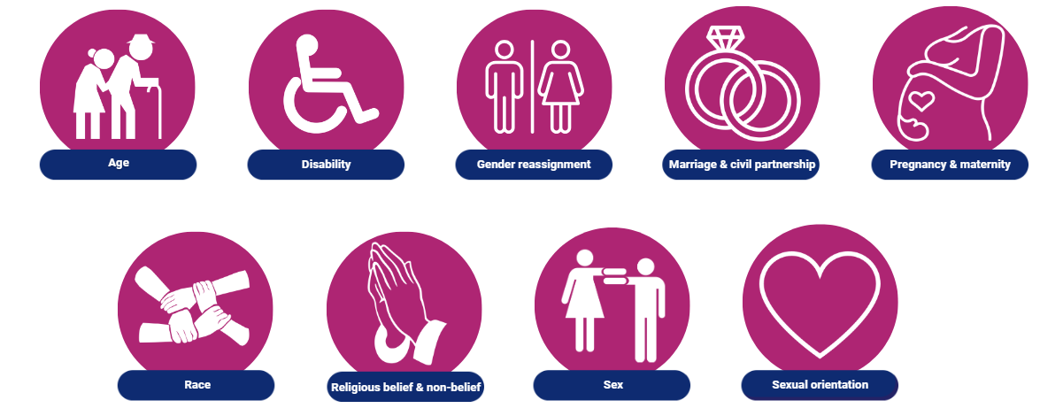
Equality Act 2010

Slide 22
LGBTQ Rights in the UK
Same sex relationships
LGBTQ people are protected by law in the UK.
Same-sex couples can marry. This has been legal since 2014.
Same sex couples have the same rights as heterosexual couples.
Same-sex couples can adopt children and have the same parenting rights as others.
Homophobia is not allowed. It is illegal in the UK.

Slide 23
What is a DBS Check?
DBS means Disclosure and Barring Service.
A DBS check shows if someone has a criminal record.
Employers may ask for this check for certain jobs like working in healthcare, with children, or in schools.
Often the employers pays for this check to be done.

Slide 24
In summary
Sex without consent is illegal. Consent means both partners agree, are sober, and have a clear mind.
Both partners must be 16 or older to have sex.
Illegal behaviours include:
  Female Genital Mutilation (FGM) or Female circumcision –Khitan or Khatna
  Sexual assault (rape)
  Coercive or controlling behaviour
  Financial abuse, threats, intimidation
  Domestic violence, psychological or emotional abuse
  Reckless transmission of HIV
  Hate crimes against LGBTQ people

Slide 25
In summary
Please report illegal behaviour if you witness it . They do not make your asylum claim invalid.
If an asylum seeker is charged or found guilty of sexual misconduct, this can harm their claim.
The UK Home Office looks at a person’s behaviour and character when deciding on asylum. Crimes can affect the decision.
Having a criminal record can affect your DBS check and your application. Know your rights about marriage, civil partnership, sexuality, and protection from racism

Slide 26
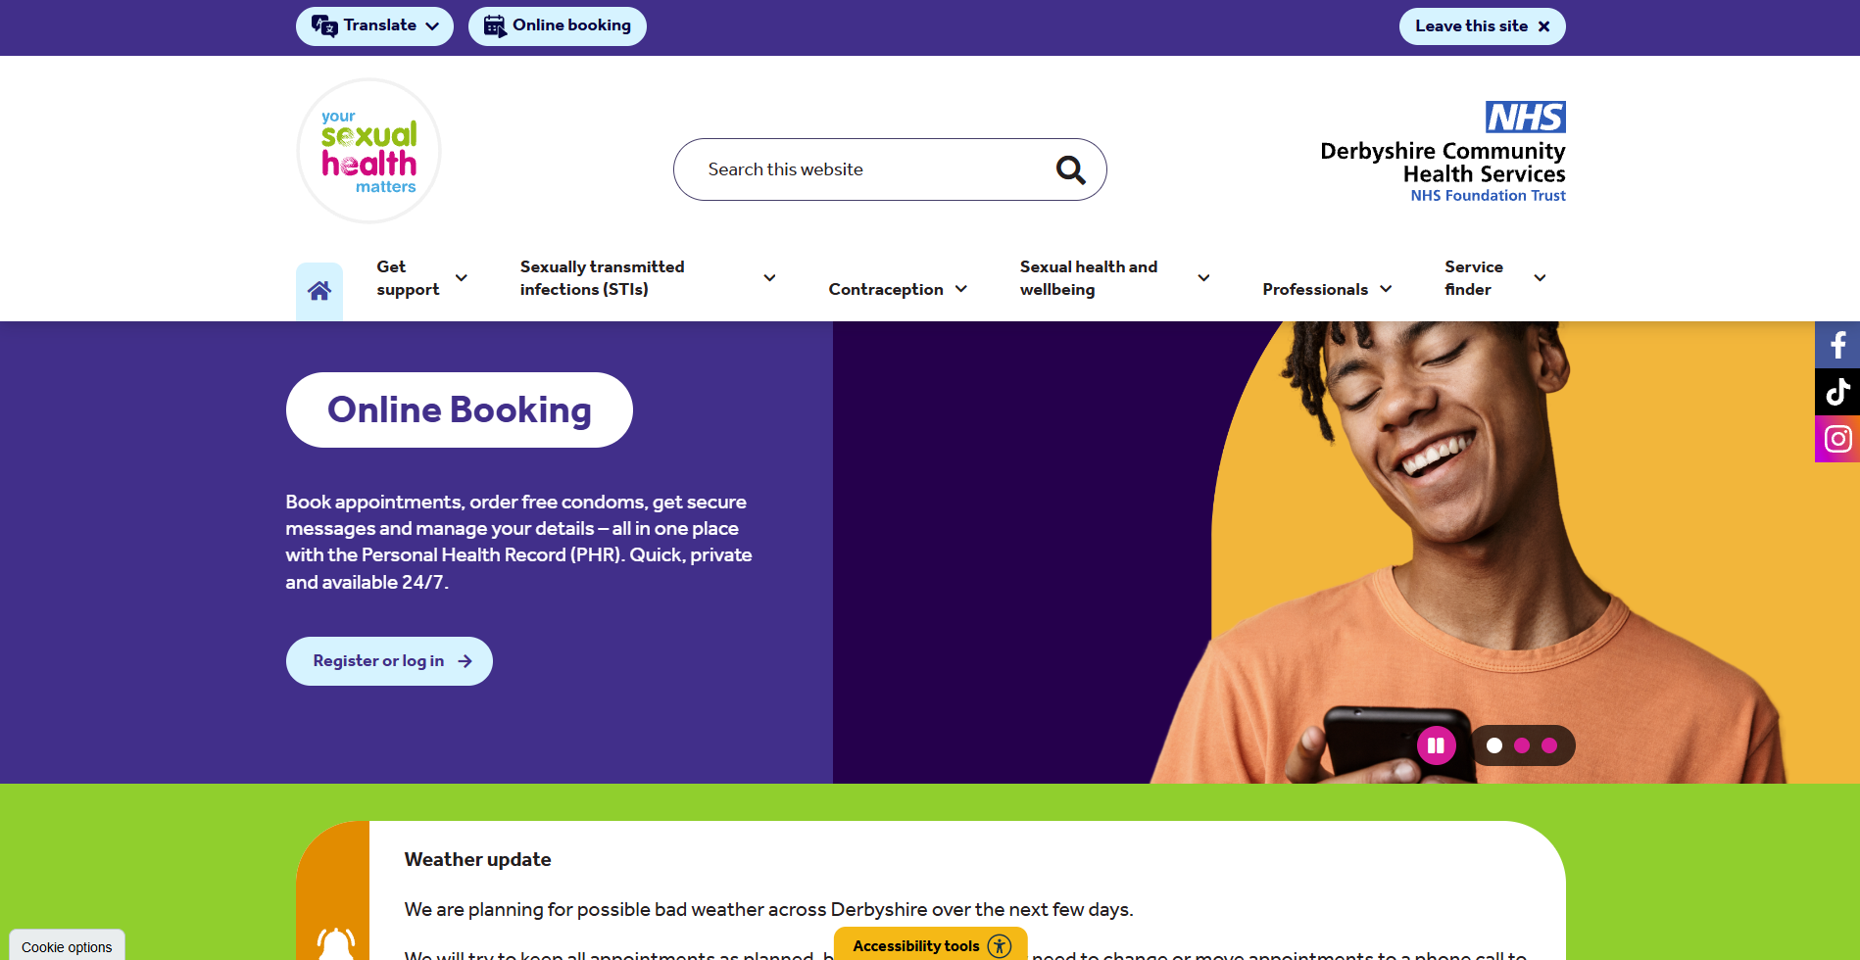

Slide 27
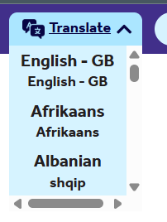
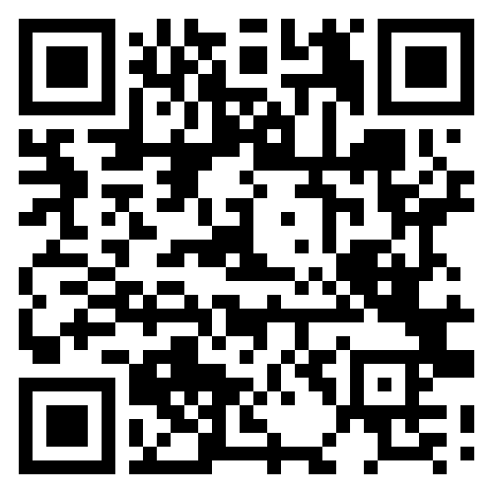
https://www.yoursexualhealthmatters.org.uk/

Slide 28
References
gov.uk/dbs-check-applicant-criminal-record
migranthelpuk.org.
cps.gov.uk/legal-guidance/rape-and-sexual-offences-chapter-6-consent
brook.org.uk/your-life/sex-and-consent
yoursexualhealthmatters.org.uk
Support_to_Derby_hotels.pdf

Slide 29
Organisations and people who supported this work
David Crowther – SV2
Dr Victor Jeganathan- Research Officer-Psychological Insights Team

Slide 30
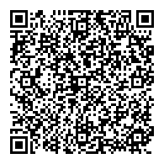
Evaluation

Slide 31

Helping to reduce anxiety about visiting our clinics, by producing “What to Expect” videos for all of our clinics, also easily accessible via Smart Phone.

