Slide 1
Sex & healthy relationships: Welcome to new arrivals
This session will be delivered in a non-judgmental, factual manner, allowing participants to ask questions and share their experiences in a safe environment.

Slide 2
Charles Dewa, Sexual Health Promotion Practitioner Delivered in partnership with the Red Cross, Derby

Slide 3
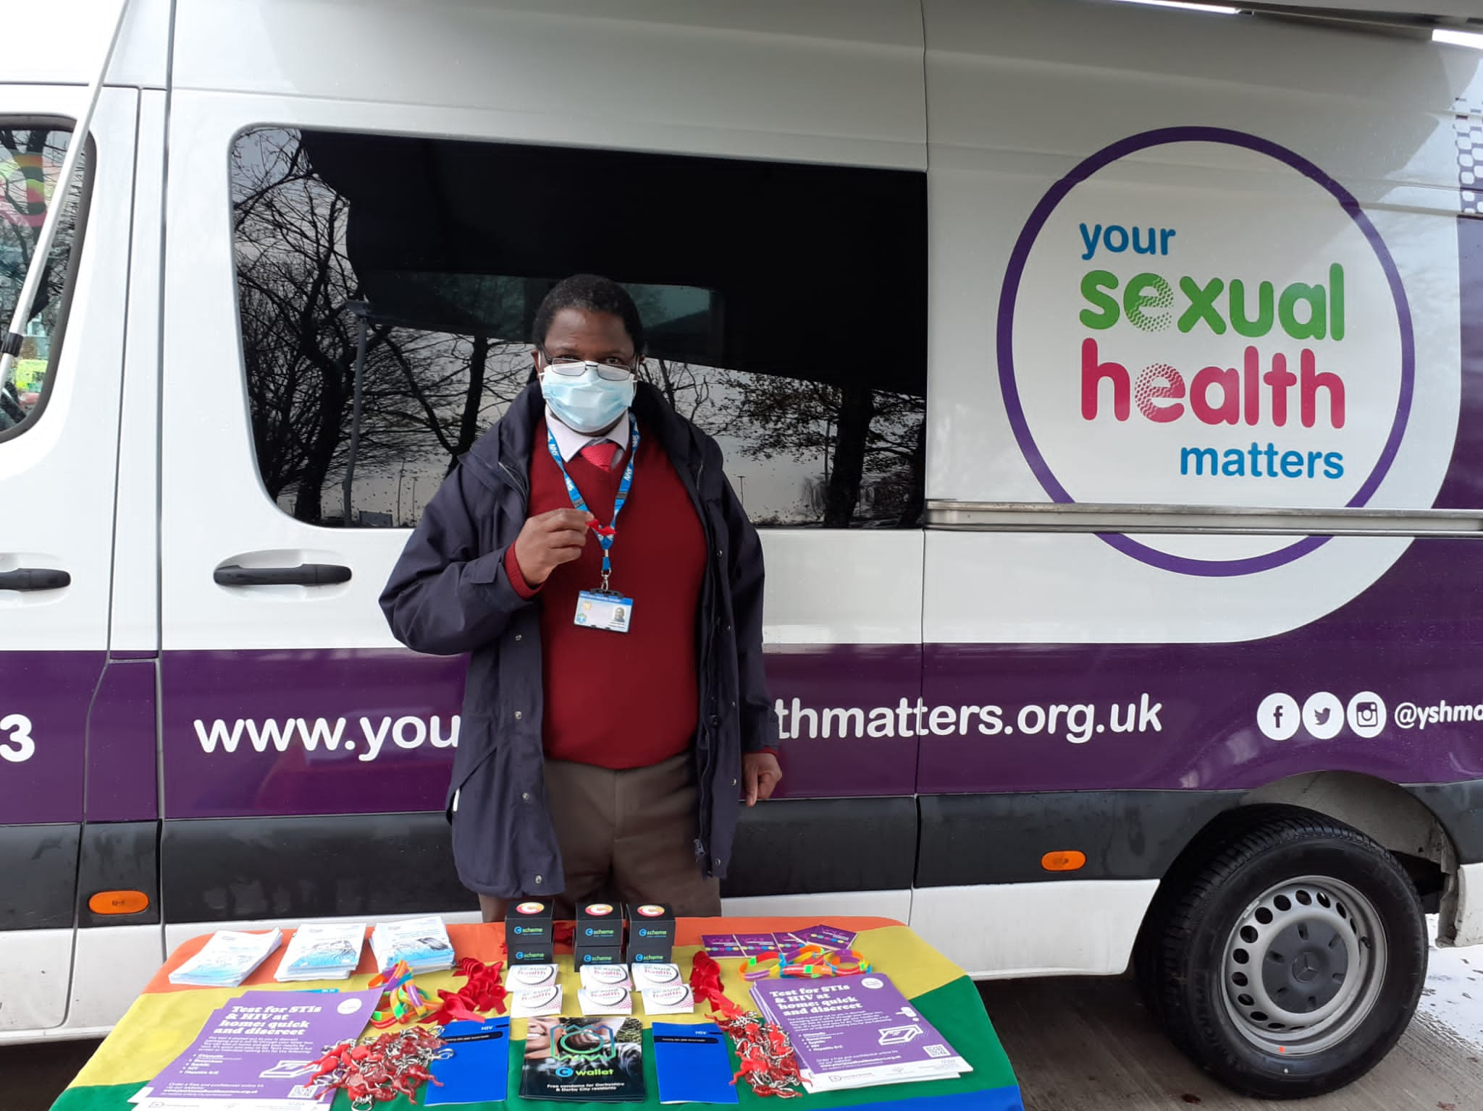
My role as Practitioner for ethnically diverse communities…
Works to achieve a greater understanding of the impact of cultural diversity, beliefs, and religion on sexual health in different communities.
Works together with community organisations and leaders to ensure culturally sensitive ways of accessing services
Aims to increase engagement with sexual health services for our ethnic diverse communities.

Slide 4
Derby new arrival alliance
There are several organisations providing support:
Care4Calais
Derby Food 4 Thought Alliance
Derby Refugee Advice Centre, 99 Curzon Street
Derbyshire Refugee Solidarity, St Anne's Church Hall
Derbyshire Community Health Services NHS Foundation Trust, Florence Nightingale Community Hospital
Food & Education Enterprise (FEE), 119 Osmaston Road
Serco
Upbeat Communities, Trinity Baptist Church, Green Lane
British Red Cross, 7 Liversage Street

Slide 5
Group agreement
Listen
Respect
Confidentiality
Contribute
Look after yourself & others- some topics can be sensitive
Ask questions- write on a piece of paper & give them to me at the end

Slide 6
What will you learn today?
Understand differences between your home country & UK about Sex and healthy relationships
Understand how Religion or beliefs can influence our understanding of sexual relationships and sexual health
Understand legal framework in the UK with reference to sexual health and relationships
Ability to make informed choices when it comes to sex and relationship.

Slide 7
Religious influences on sexual expression
Christian perspectives- traditional Anglican views emphasise sex within marriage. Liberal denominations increasingly accept diverse relationships.
Muslim communities- sex is generally reserved for marriage. Greater emphasis on modesty and privacy. Varying interpretations across communities.
Jewish traditions- Orthodox views maintain marriage focus. Reform Judaism more accepting of diverse relationships.
Hindu and Sikh beliefs- Traditional emphasis on marital sex. Generational evolution of attitudes among British Asians.

Slide 8
Regional and ethnic diversity
South Asian communities- Family involvement in mate selection remains important.
Cultural expectations about virginity more prevalent.
Arranged introductions are still common.
Growing acceptance of dating.

Slide 9
Media influences on sexual expectations
British television- shows as ‘Love Island’ shape modern relationship expectations. Portrayal of casual sex as normative.
Television dramas- often explore relationship complexities beyond physical intimacy.
Print media- women’s magazines emphasise sexual satisfaction.
Dating Apps- different apps reflect various relationship goals. Expectations around physical intimacy.
Social media- creates pressure for ‘perfect’ relationships.

Slide 10
Consent is essential and a legal obligation for any sexual activity
What is consent?
The Sexual Offences Act 2003 (England and Wales) defines consent as when a person ‘agrees by choice and has the capacity to make that choice’ e.g. must have sound mind, no alcohol, or substance use.
Focus on communication and boundaries:
Clear
Voluntary
Informed agreement
No pressure or coercion
Sexual consent is a crucial aspect of healthy sexual relationships and is legally defined in the UK law.

Slide 11
Sexual consent laws in the UK
Age of consent in UK is 16 years old (under 16s cannot consent legally to sexual activity).
Sexual activity with someone under 16 is illegal.
Consent can be withdrawn at anytime, even during the activity.
“No” means “No”
Silence is not consent.
Changing consent - consent can be given for one activity and not another.

Slide 12
Illegal behaviour in a relationship
In the UK, several behaviours are illegal in relationships, particularly those that involve abuse or coercion.
Key examples:
Physical and Sexual Abuse- e.g. physical violence, or assault is illegal.
Sexual assault-non-consensual sexual activity is a criminal offense e.g. rape in marriage.
FGM (Female Genital Mutilation) or cutting or female circumcision- is illegal in the UK and a very serious safeguarding issue. FGM Act 2003 or Prohibition of Female Genital Mutilation (Scotland) Act 2005.

Slide 13
Coercive and controlling behaviour
Controlling Daily Activities: Dictating what someone wears, who they see, or how they spend their time.
Financial Abuse: Taking control of someone's finances or restricting their access to money.
Isolation: Preventing someone from seeing friends or family.
Threats and Intimidation: Using threats or intimidation to control or frighten someone.

Slide 14
Legal framework
Coercive Control:
The Serious Crime Act 2015 criminalizes controlling or coercive behaviour in intimate or family relationships, with penalties of up to five years in prison.

Slide 15
Sexual misconduct and seeking asylum claim
Sexual assault and abuse are crimes and should be reported, these incidents themselves do not affect the validity of an asylum claim.
However, if an asylum seeker is accused or convicted of sexual misconduct, it could negatively influence their claim.
The UK Home Office considers the character and behaviour of the applicant when assessing asylum claims, and criminal behaviour can be a factor in their decision-making process.

Slide 16
Domestic violence and abuse
Protection Orders: Legal measures like non-molestation orders and occupation orders can protect individuals from domestic abuse.
Support Services: Various organizations provide support and advice for those experiencing domestic violence.

Slide 17
Psychological and emotional abuse
Repeated insults: Constantly putting someone down or mocking them.
Scaring someone: Using gestures, destroying possessions, or making threats to instil fear.

Slide 18
Reckless Transmission of HIV Laws in the UK Legal Framework in England and Wales
Prosecution under Offences Against the Person Act 1861
Two offences: Reckless (Section 20) & Intentional (Section 18)
Maximum 5 years for reckless, life imprisonment for intentional
Must prove actual HIV transmission occurred

Slide 19
Conditions for Reckless Transmission Prosecution
The accused knew they were HIV positive at time of sex
Had sex without condom or protection
Partner unaware of HIV status
HIV was transmitted to the partner
Recklessness defined by knowingly taking risk

Slide 20
Relationships & the law in UK, please consider:
Marriage & civil partnerships
Marriage: A legal union between two people, usually with a ceremony to exchange vows. Recognised by law, which provides various legal rights and responsibilities.
Civil Partnerships: Often chosen by couples who don’t want a religious or formal or religious ceremony. Same legal rights and legal recognition as marriage but the procedure is different.
Living Together: Couples who live together without being married or in a civil partnership are known as cohabitants. They have fewer legal rights compared to married couples.
Same sex couples are recognised and have the same legal rights and duties as heterosexual couples in the UK

Slide 21
Divorce & separation
Grounds for divorce: The main ground for divorce is the irretrievable breakdown of the marriage. This could sometimes include adultery, unreasonable behaviour, desertion, or separation for a certain period. The only requirement is that the couple has been married for at least one year.
Financial settlements: Legal processes to divide assets, workout arrangements for children, and finances fairly between partners upon divorce or separation.

Slide 22
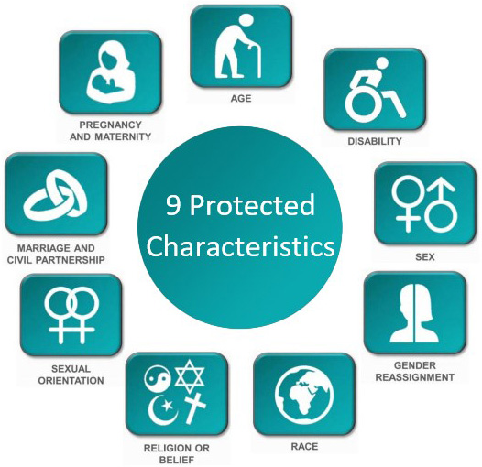
Equality Act 2010

Slide 23
LGBTQ people are legally protected in UK
Same-Sex marriage: Legal since 2014, allowing same-sex couples to marry and enjoy equal protection by law as heterosexuals
Adoption and parental rights: Same-sex couples can legally adoption and have equal rights of parental responsibilities as heterosexuals.
Homophobia is always unacceptable in UK culture and is illegal by law

Slide 24
DBS : Disclosure and Barring Service
DBS check
Employers can check the criminal record of someone applying for a role
For example, roles in healthcare, childcare or education.

Slide 25
...in summary
Nonconsensual sex is illegal - consent is important, partner should have right frame of mind, no substance use or mental health.
Both partners must be 16 years and above to have sex.
Illegal behaviour e.g. FGM, sexual assault (rape), coercive and controlling behaviour, financial, threats, intimidation, domestic violence, abuse, psychological, emotional abuse, reckless transmission of HIV & hate crime (towards LGBTQ communities) may affect rating with your application DBS.
Also understand marriage & civil partnership, or rights to sexuality - LGBTQ rights or racism.

Slide 26
Legal Advice or Support
Citizens Advice: Provides free legal advice and support on various relationship issues, including marriage, cohabitation, and domestic violence
Lawyers
Advocates
Local Refugee Forum
Migrant Help
Red Cross, Derby
Sexual Health Promotion team
LGBTQ+, Chesterfield and Derby

Slide 27
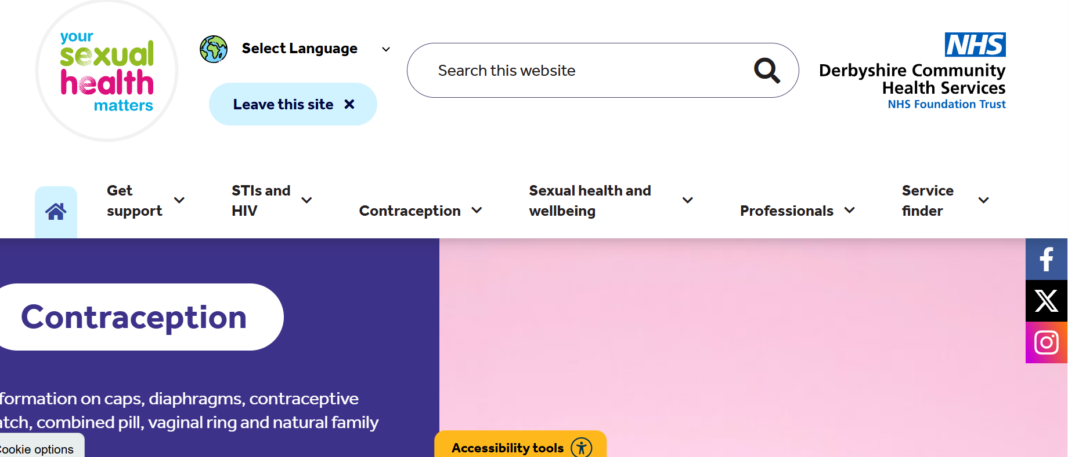

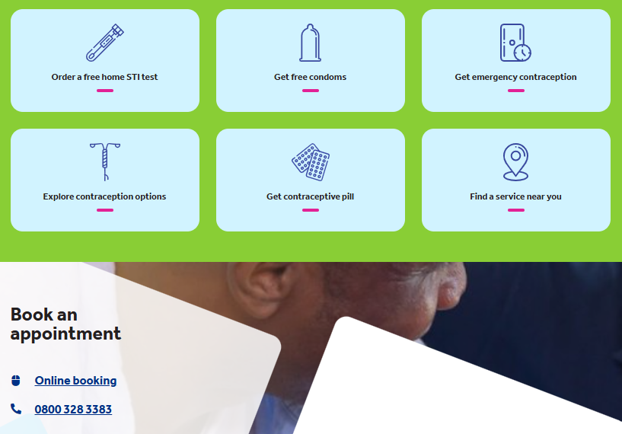
Our Website

Slide 28
References
gov.uk/dbs-check-applicant-criminal-record
migranthelpuk.org.
cps.gov.uk/legal-guidance/rape-and-sexual-offences-chapter-6-consent
brook.org.uk/your-life/sex-and-consent
yoursexualhealthmatters.org.uk
Support_to_Derby_hotels.pdf

